Slide 1
Figure 1
A
B

Slide 2
Figure 2: average methylation level by gene region and treatment

Slide 3
A
B
Notes:
Figure 3A: clustering of the samples with Euclidean distances calculated using methylation levels of the samples. Tumor samples (marked “t”) are clearly separated form normal tissue samples. Additionally, there is a strong time effect.
Figure 3B: clustering of the samples with principal components analysis calculated using methylation levels of the samples. Tumor samples (marked “t”) are clearly separated form normal tissue samples.

Slide 4
A
B
Notes:
Figure 4A: clustering of the samples with Euclidean distances calculated using methylation levels of the samples. Tumor samples are excluded. There is a strong time effect. Additionally, control samples at 15 and 25 weeks are clustered together.
Figure 4B: clustering of the samples with principal components analysis calculated using methylation levels of the samples. Tumor samples are excluded. There is a strong time effect. Additionally, control samples are clustered together.

Slide 5
A
B
C
Notes:
Figure 5: change in methylation over time in control group non-tumorous tissue. Larger number of differentially methylated regions (DMR) changed their methylation level form baseline (Week 2) compared to the number of statistically significant DMRs between weeks 15 and 25.

Slide 6
A
Figure 6
Table 1
B
Notes:
Figure 6: changes in methylation levels over time in controls. The outermost layer corresponds to Week 15 – Week 2 difference; the middle layer is Week 25 – Week 2, and the innermost layer is Week 25 – Week 15. Only CpG regions with at least 20% difference in methylation and FRD < 0.01 for the first two comparisons are presented.

Slide 7
A
B
Figure 7: change in methylation at week 2 in UVB vs. SFN. Larger number of DMRs were found between UVB and negative control compared to UVB and SFN.

Slide 8
A
Figure 8
Table 2
C
B
740-16=724
16
54-16=38
3,151-22=3,129
22
51-22=29
Notes:
Figure 8: change in methylation at week 2 in UVB vs. SFN. 17 DMRs were hypermethylated in UVB compared to control and hypomethylated in SFN compared to UVB (FDR < 0.1). 25 DMRs were hypomethylated in UVB compared to control and hypomethylated in SFN compared to UVB (FDR < 0.1).

Slide 9
A
B
Figure 9: change in methylation at week 2 in UVB vs. SFN. Larger number of DMRs were found between UVB and negative control compared to UVB and SFN.

Slide 10
A
B
1,214-12=1,202
12
36-12=24
1,425-7=1,418
7
24-7=17
C
Gene | Start | UVB - Control | SFN - UVB
0610040F04Rik | 108570128 | 0.326 | -0.367
Ccdc97 | 25704771 | 0.225 | -0.217
Cdh10 | 18717794 | 0.112 | -0.130
Mageh1 | 153037133 | 0.130 | -0.162
Mturn | 54698998 | 0.270 | -0.247
Mturn | 54699509 | 0.288 | -0.266
Mzt1 | 98959330 | 0.158 | -0.155
Pcdha1 | 36930800 | 0.130 | -0.136
Pfdn5 | 102325379 | 0.383 | -0.378
Soga1 | 157052749 | 0.371 | -0.338
Stat1 | 52171602 | 0.208 | -0.206
Tbx1 | 18586337 | 0.141 | -0.134
1700049E22Rik | 100424971 | -0.048 | 0.064
Cul4b | 38564678 | -0.149 | 0.195
Gse1 | 120437638 | -0.124 | 0.087
Kcnk12 | 87794115 | -0.349 | 0.350
Plcb3 | 6970784 | -0.112 | 0.191
Rtcb | 85967898 | -0.090 | 0.153
Tab3 | 85573831 | -0.194 | 0.294
Figure 10
Table 3

Slide 11
A
B
Figure 11: change in methylation at week 25 in UVB vs. SFN. Larger number of DMRs were found between UVB and negative control compared to UVB and SFN.

Slide 12
A
B
641-16=625
16
97-16=81
C
Gene | Start | UVB - Control | SFN - UVB
4933407K13Rik | 75723626 | 0.182 | -0.193
Alkbh3 | 94010830 | 0.081 | -0.084
Angpt1 | 42376792 | 0.245 | -0.335
Brca1 | 101519278 | 0.104 | -0.120
Cdc14a | 116436239 | 0.296 | -0.279
Cdc14a | 116461327 | 0.264 | -0.290
Exoc3l4 | 111423310 | 0.123 | -0.124
Gja10 | 32601032 | 0.135 | -0.139
Gm12596 | 59281276 | 0.214 | -0.253
Lpar1 | 58544789 | 0.283 | -0.367
Mn1 | 111419677 | 0.220 | -0.246
Mup5 | 61930624 | 0.145 | -0.198
Pdcd2 | 15536454 | 0.770 | -0.819
Prickle1 | 93521895 | 0.280 | -0.409
Ptpro | 137252656 | 0.105 | -0.101
Ugcg | 59216879 | 0.306 | -0.408
1700029N11Rik | 44455980 | 0.006 | -0.002
1810046K07Rik | 51313019 | -0.071 | 0.081
2410124H12Rik | 92475219 | -0.065 | 0.088
A930005H10Rik | 115848435 | -0.391 | 0.352
Anks1 | 28048473 | -0.263 | 0.240
Bcor | 12081571 | -0.149 | 0.109
Clic5 | 44455980 | -0.247 | 0.192
Gtf2i | 134333082 | -0.107 | 0.117
Lamc2 | 153172234 | -0.078 | 0.086
Loxhd1 | 77366869 | -0.221 | 0.158
Ntrk2 | 58927842 | -0.179 | 0.208
Ric8b | 84918966 | -0.175 | 0.191
Ric8b | 84986110 | -0.219 | 0.253
Scml4 | 42864113 | -0.067 | 0.076
Slc35a3 | 116723548 | -0.186 | 0.307
Spata5l1 | 122629154 | -0.075 | 0.145
Zkscan16 | 58935378 | -0.136 | 0.133
795-16=779
16
66-16=50
Figure 12
Table 4

Slide 13
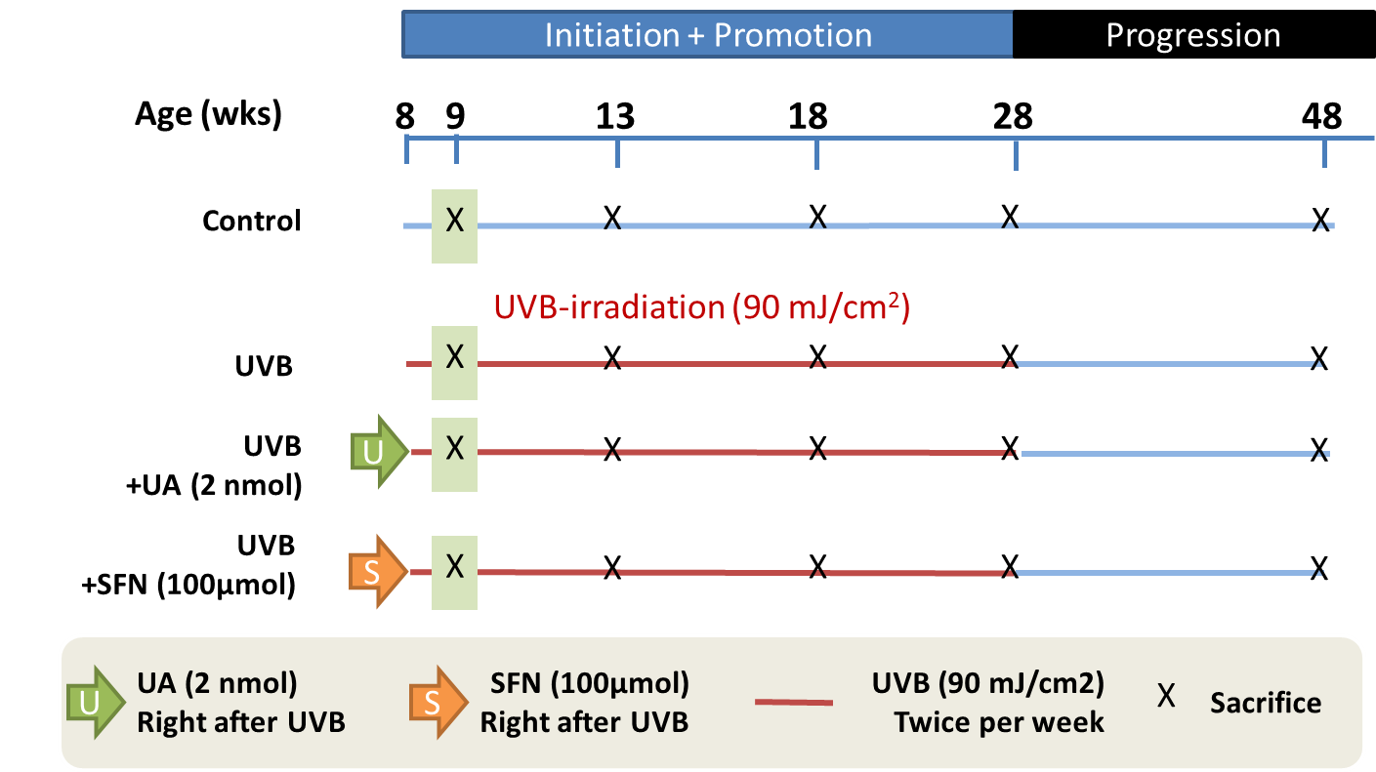
A
B
Add histo
Supplementary Figure 1

